Slide 1

2019 YoungLife North Louisiana
Leadership Roundup
Committee Training
January 26, 2019

Slide 2
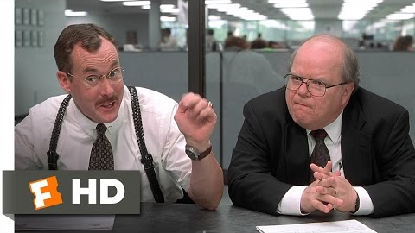

Slide 3
What’s your motivation for being on YL Committee?

Slide 4
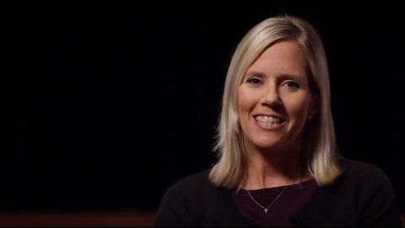

Slide 5
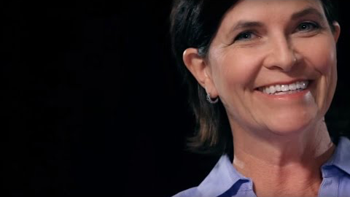

Slide 6
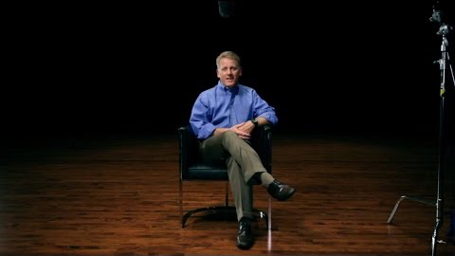

Slide 7
What’s your motivation for being on YL Committee?

Slide 8
For “everyone who calls on the name of the Lord will be saved.”
How then will they call on Him in whom they have not believed?
And how are they to believe in Him of whom they have never heard? And how are they to hear without someone preaching?
Romans 10:13-14

Slide 9
Committee Purpose Statement
Our purpose is to actively support the ministry of Young Life
Through fundraising, securing administrative resources,
and encouraging staff and volunteers.
We will protect the integrity of the ministry, ensure
fiscal responsibility, and pray for the spiritual strength of the leadership.

Slide 10
Assessment of your committees
  Strengths
  Weaknesses
  Opportunities
  Threats
  Your role

Slide 11
Working Session
  What does your committee need most from you?
  What does your staff need most?
  What do your leaders need most?
  What are your challenges to meeting those needs?
  How can you overcome those challenges?

Slide 12
Break

Slide 13
CHARACTERISTICS OF EFFECTIVE COMMITTEES
Are built on the right foundation
Have goals and action plans for success
Are structured to accomplish goals and plans and support the ministry
Ensure adequate financial support
Understand authority and decision making in YL
Plan and hold effective meetings
Appreciate, celebrate, and say thanks
Evaluate themselves

Slide 14
Commitments and Responsibilities

Slide 15
TRADITIONAL STRUCTURE WITH SUBCOMMITTEES
Events
SUB-COMMITTEE
Leader Care
SUB-COMMITTEE
COMMITTEE
Prayer-
Communication
SUB-COMMITTEE
IDT
Investor Development
Team

Slide 16
Questions & Key Takeaways

Slide 17
2019 YoungLife North Louisiana
Leadership Roundup
Committee Training
January 26, 2019

